Slide 1
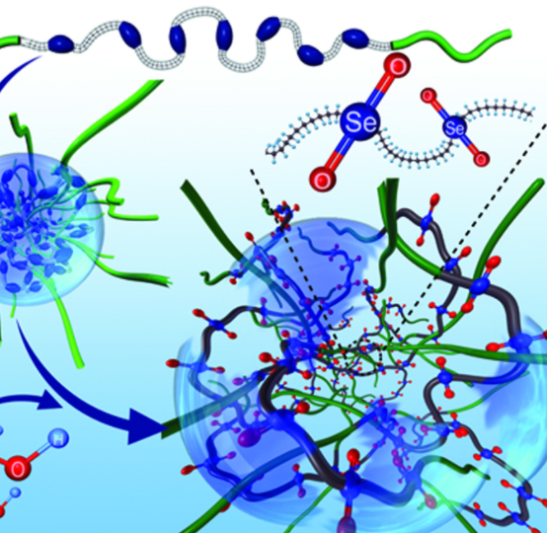
Organic Reactions and Reaction Pathways
Unit 4 –Structure, Synthesis and Design
Topic 1 – Properties and Structure of Organic Materials
Oxford Chemistry U 3 & 4 Chapter 10

Slide 2
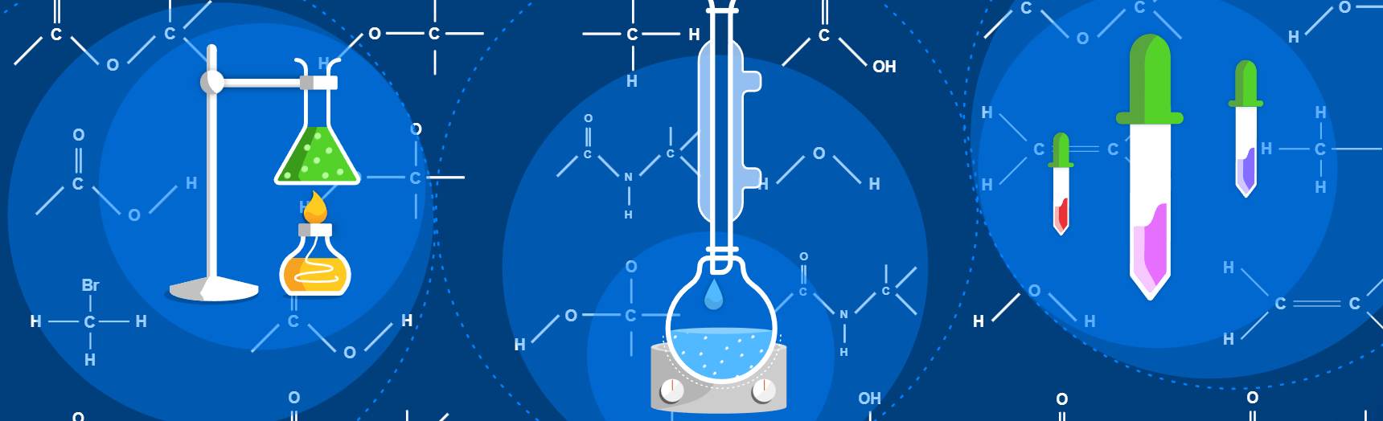
Introduction
Organic reactions involve breaking strong covalent bonds. This often requires the input of energy, such as heat or UV radiation, or catalysis in the form of specific chemicals. Common reactions include addition, elimination, oxidation, reduction, condensation and substitution (of which there are many subcategories). Organic reactions are happening constantly and all around us, not just in the laboratory. They are involved with the production of cellulose in plants and DNA in cells and in the biochemical pathways that take place within our bodies.

Slide 3
Summary of the Chemical Pathways:
KEY POINT:
This section is going to cover a lot of reactions, and yes, you do need to know all of these, including the conditions under Which they occur. The good news is that you don't need to know the mechanisms of how and why they occur (i.e. how charges and atoms move around in the reactions is not assessable). Let's jump in!

Slide 4
Saturated vs. Unsaturated Molecules
Saturated compounds only contain single bonds, whereas unsaturated compounds have at least one double or triple bond. By definition, alkanes are saturated whereas alkenes and alkynes are unsaturated.
This has implications for the types of reactions these molecules can undergo. In an addition reaction, atoms are added to a molecule without any atoms being removed from the molecule. Saturated compounds don't have any 'spare bonds' so to add new atoms an existing atom would have to be kicked out. Thus, saturated molecules don't undergo addition reactions. By contrast, since unsaturated compounds can open up a duplicate bond and accept new atoms there, they do undergo addition reactions. The type of reaction a saturated compound can undergo, where existing atom/s are switched out for new one/s are called substitution reactions.

Slide 5
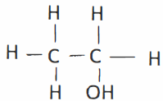
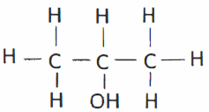
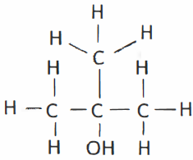
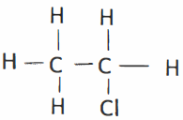
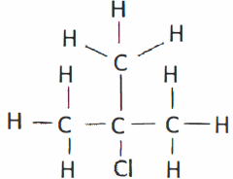
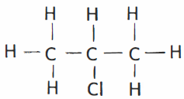
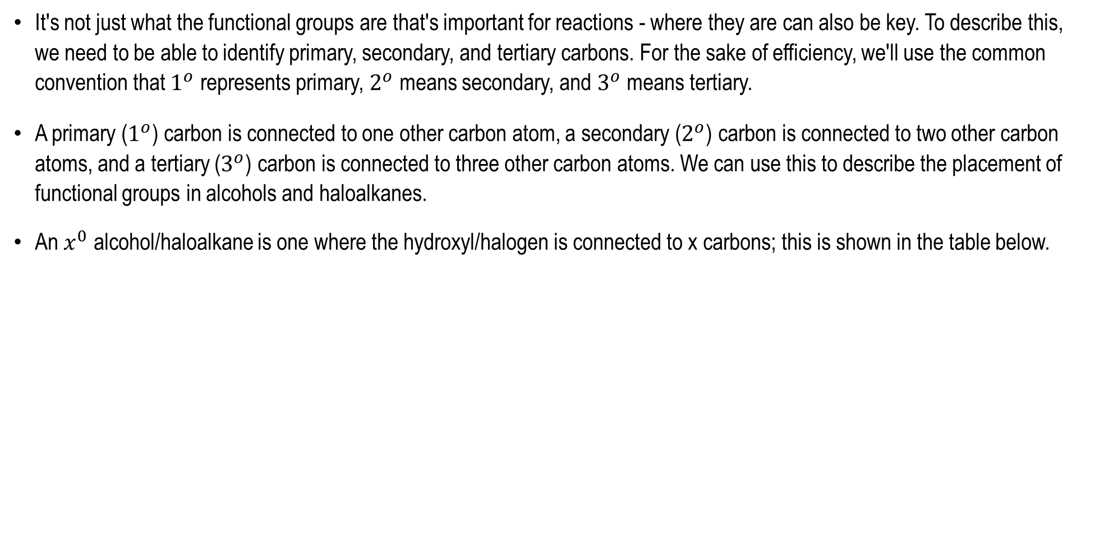
Primary, Secondary, and Tertiary Carbons
It's not just what the functional groups are that's important for reactions - where they are can also be key. To describe this, we need to be able to identify primary, secondary, and tertiary carbons. For the sake of efficiency, we'll use the common convention that $1^{o}$ represents primary, $2^{o}$ means secondary, and $3^{o}$ means tertiary.
A primary ($1^{o}$) carbon is connected to one other carbon atom, a secondary ($2^{o}$) carbon is connected to two other carbon atoms, and a tertiary ($3^{o}$) carbon is connected to three other carbon atoms. We can use this to describe the placement of functional groups in alcohols and haloalkanes.
An $x^{0}$ alcohol/haloalkane is one where the hydroxyl/halogen is connected to x carbons; this is shown in the table below.
Ethanol is a primary alcohol | Propan-2-ol is a secondary alcohol | 2-methylpropan-2-ol is a tertiary alcohol
Chloroethane is a primary haloalkane | 2-chloropropane is a secondary haloalkane | 2-chloro-2-methylpropanane is a tertiary haloalkane

Slide 6
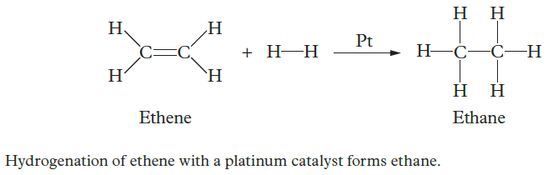
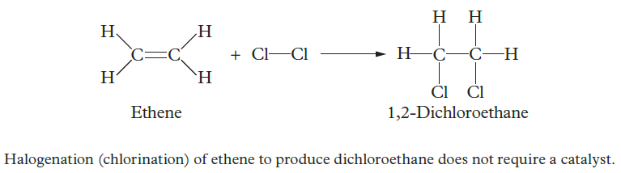
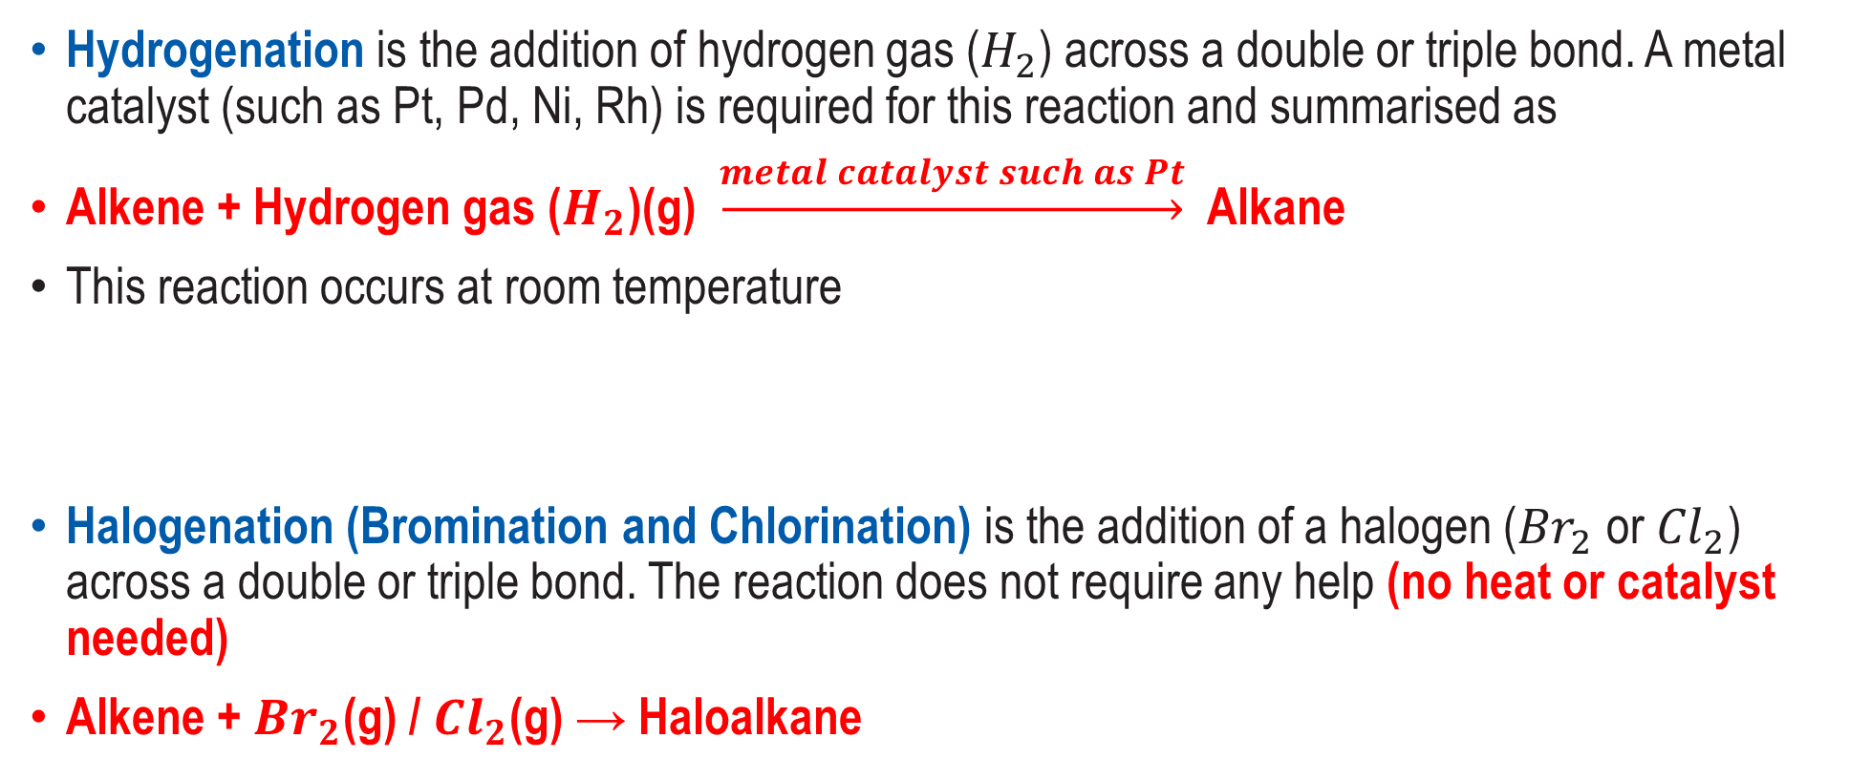
Addition Reactions
Addition reactions are organic reactions that occur when atoms are added across a double or triple bond of an unsaturated hydrocarbon.
Hydrogenation is the addition of hydrogen gas ($H_{2}$) across a double or triple bond. A metal catalyst (such as Pt, Pd, Ni, Rh) is required for this reaction and summarised as
Alkene + Hydrogen gas ($H_{2}$)(g) $\underset{→}{metal catalyst such as Pt}$ Alkane
This reaction occurs at room temperature
Halogenation (Bromination and Chlorination) is the addition of a halogen (${Br}_{2}$ or ${Cl}_{2}$) across a double or triple bond. The reaction does not require any help (no heat or catalyst needed)
Alkene + ${Br}_{2}$(g) / ${Cl}_{2}$(g) → Haloalkane

Slide 7
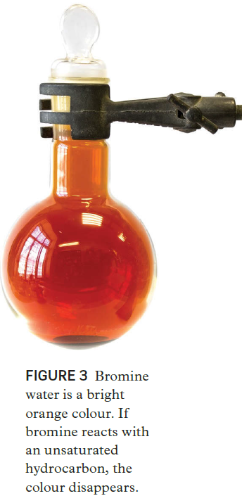
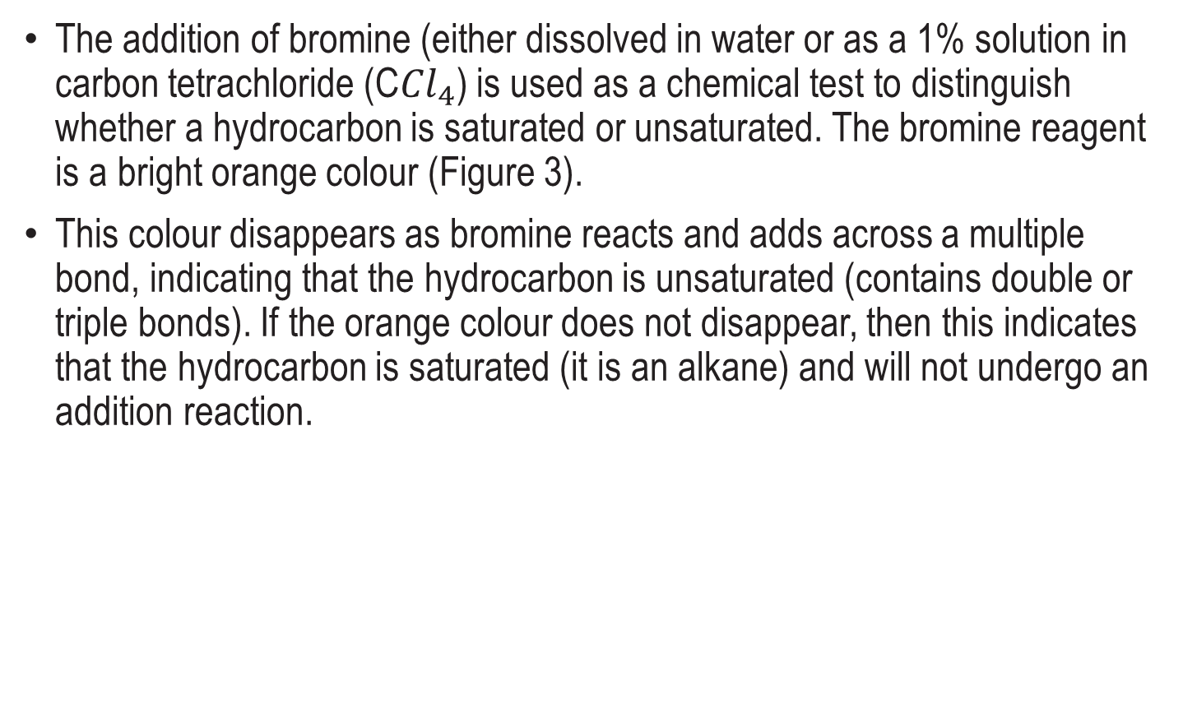
Chemical Tests to Distinguish Alkanes and Alkenes
The addition of bromine (either dissolved in water or as a 1% solution in carbon tetrachloride (C${Cl}_{4}$) is used as a chemical test to distinguish whether a hydrocarbon is saturated or unsaturated. The bromine reagent is a bright orange colour (Figure 3).
This colour disappears as bromine reacts and adds across a multiple bond, indicating that the hydrocarbon is unsaturated (contains double or triple bonds). If the orange colour does not disappear, then this indicates that the hydrocarbon is saturated (it is an alkane) and will not undergo an addition reaction.

Slide 8
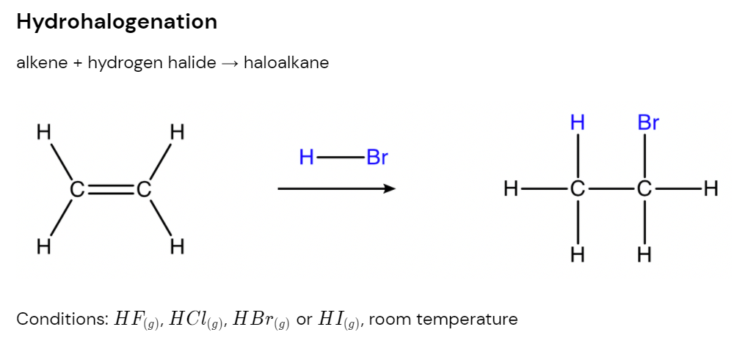
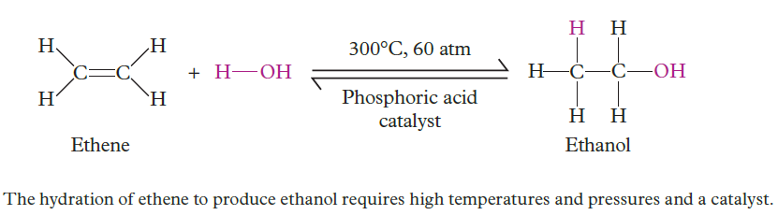
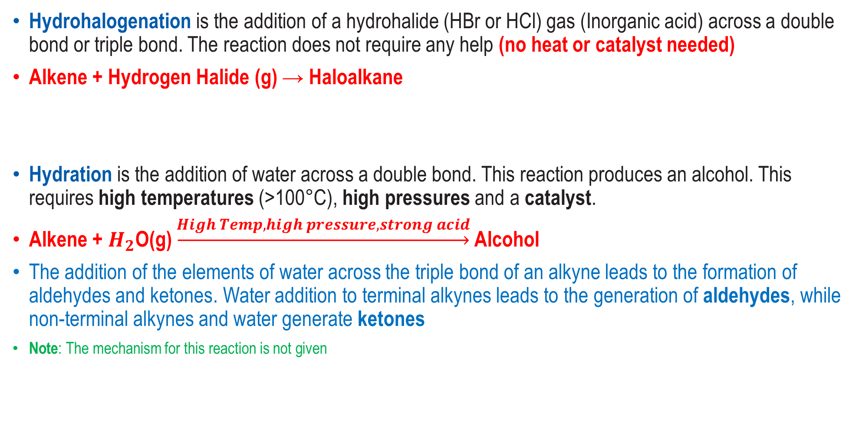
More Addition Reactions
Hydrohalogenation is the addition of a hydrohalide (HBr or HCl) gas (Inorganic acid) across a double bond or triple bond. The reaction does not require any help (no heat or catalyst needed)
Alkene + Hydrogen Halide (g) → Haloalkane
Hydration is the addition of water across a double bond. This reaction produces an alcohol. This requires high temperatures (>100°C), high pressures and a catalyst.
Alkene + $H_{2}$O(g) $\underset{→}{High Temp, high pressure, strong acid}$ Alcohol
The addition of the elements of water across the triple bond of an alkyne leads to the formation of aldehydes and ketones. Water addition to terminal alkynes leads to the generation of aldehydes, while non-terminal alkynes and water generate ketones
Note: The mechanism for this reaction is not given

Slide 9
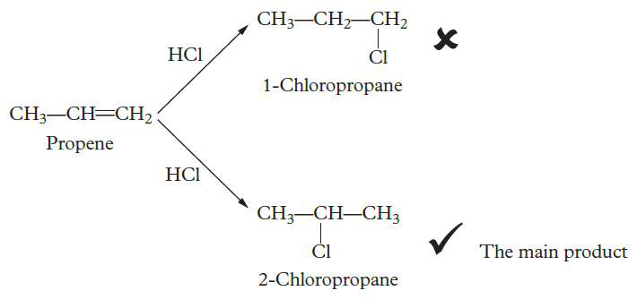
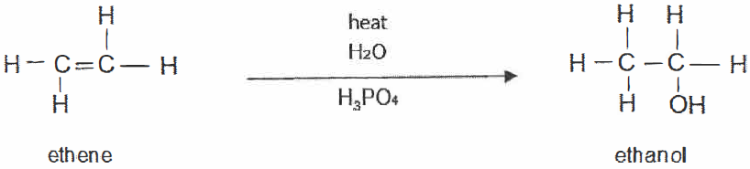
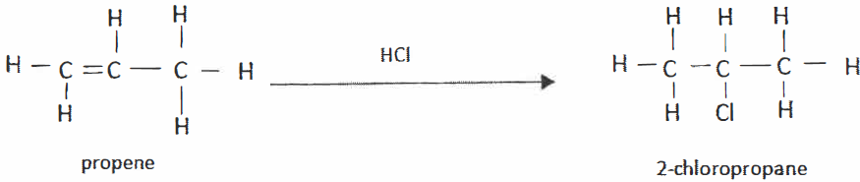
Markovinikov's Rule
For the previous examples of reactions, the alkenes are symmetrical, so it doesn't matter which carbon atom gets the hydrogen atom and which gets the halogen.
However, if an alkene isn't symmetrical, it's not just random chance which atom goes to which carbon.
The hydrogen atom is more likely to bond with a carbon atom that has more hydrogens bound to it and the halogen is more likely to bond with a carbon atom with fewer hydrogens bound to it.
This is called Markovinikov's Rule.
E.g.
Study tip
Use the analogy ‘the rich get richer’ to help remember that Markovnikov’s rule states that the hydrogen atom will go to the carbon with the most hydrogen atoms.
Usually a reaction produces about 90% Markovinikov’s product and about 10% of the ant-Markovinikov’s product

Slide 10
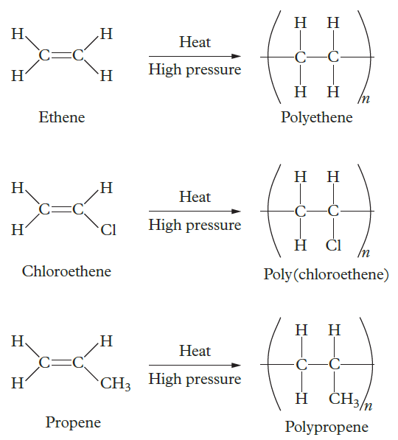
Polymerisation
Polymerisation is the successive addition reactions of alkene monomers (or single unit of the polymer) to form a polymer. A catalyst is required to break the double bond and produce a long chain of carbon atoms.
Polymerisation is a self-addition reaction. This means that if other reagents were present, the polymerisation reaction would be prevented from taking place. The reactions require heat, high pressure and a catalyst that helps generate unpaired non-bonding electrons.
Study tip
It is important to write the reaction conditions on the chemical equation arrow.

Slide 11
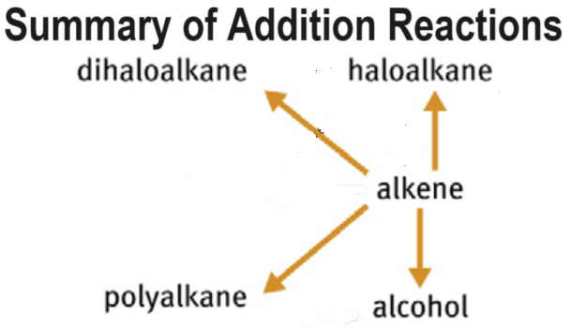

Slide 12
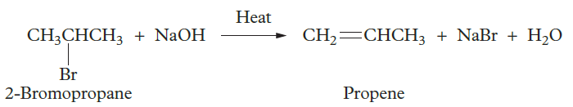
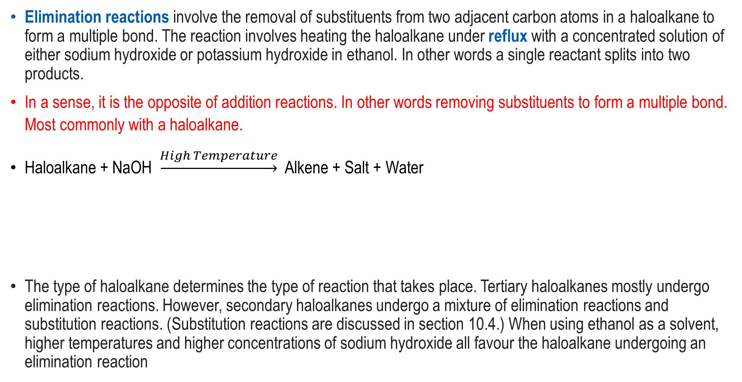
Elimination Reactions
Elimination reactions involve the removal of substituents from two adjacent carbon atoms in a haloalkane to form a multiple bond. The reaction involves heating the haloalkane under reflux with a concentrated solution of either sodium hydroxide or potassium hydroxide in ethanol. In other words a single reactant splits into two products.
In a sense, it is the opposite of addition reactions. In other words removing substituents to form a multiple bond. Most commonly with a haloalkane.
Haloalkane + NaOH $\underset{→}{High Temperature}$ Alkene + Salt + Water
The type of haloalkane determines the type of reaction that takes place. Tertiary haloalkanes mostly undergo elimination reactions. However, secondary haloalkanes undergo a mixture of elimination reactions and substitution reactions. (Substitution reactions are discussed in section 10.4.) When using ethanol as a solvent, higher temperatures and higher concentrations of sodium hydroxide all favour the haloalkane undergoing an elimination reaction

Slide 13
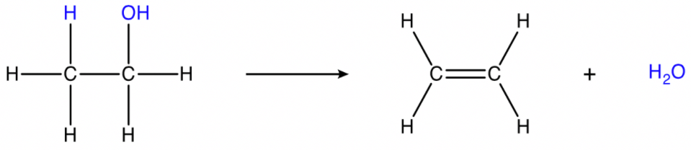
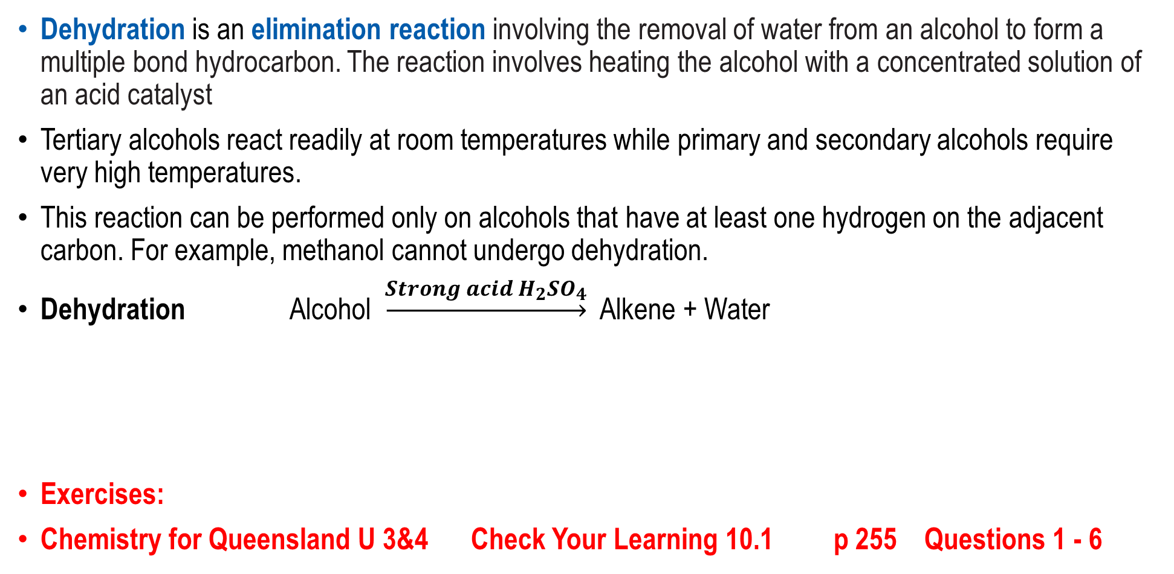
Dehydration Reactions
Dehydration is an elimination reaction involving the removal of water from an alcohol to form a multiple bond hydrocarbon. The reaction involves heating the alcohol with a concentrated solution of an acid catalyst
Tertiary alcohols react readily at room temperatures while primary and secondary alcohols require very high temperatures.
This reaction can be performed only on alcohols that have at least one hydrogen on the adjacent carbon. For example, methanol cannot undergo dehydration.
Dehydration Alcohol $\underset{→}{Strong acid H_{2}{SO}_{4}}$ Alkene + Water
Exercises:
Chemistry for Queensland U 3&4 Check Your Learning 10.1 p 255 Questions 1 - 6

Slide 14
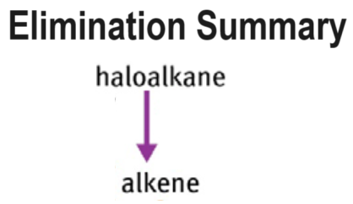

Slide 15
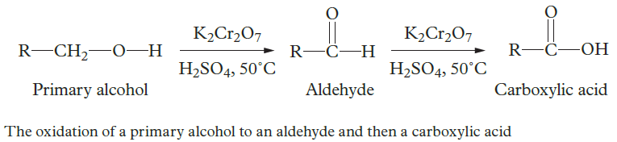
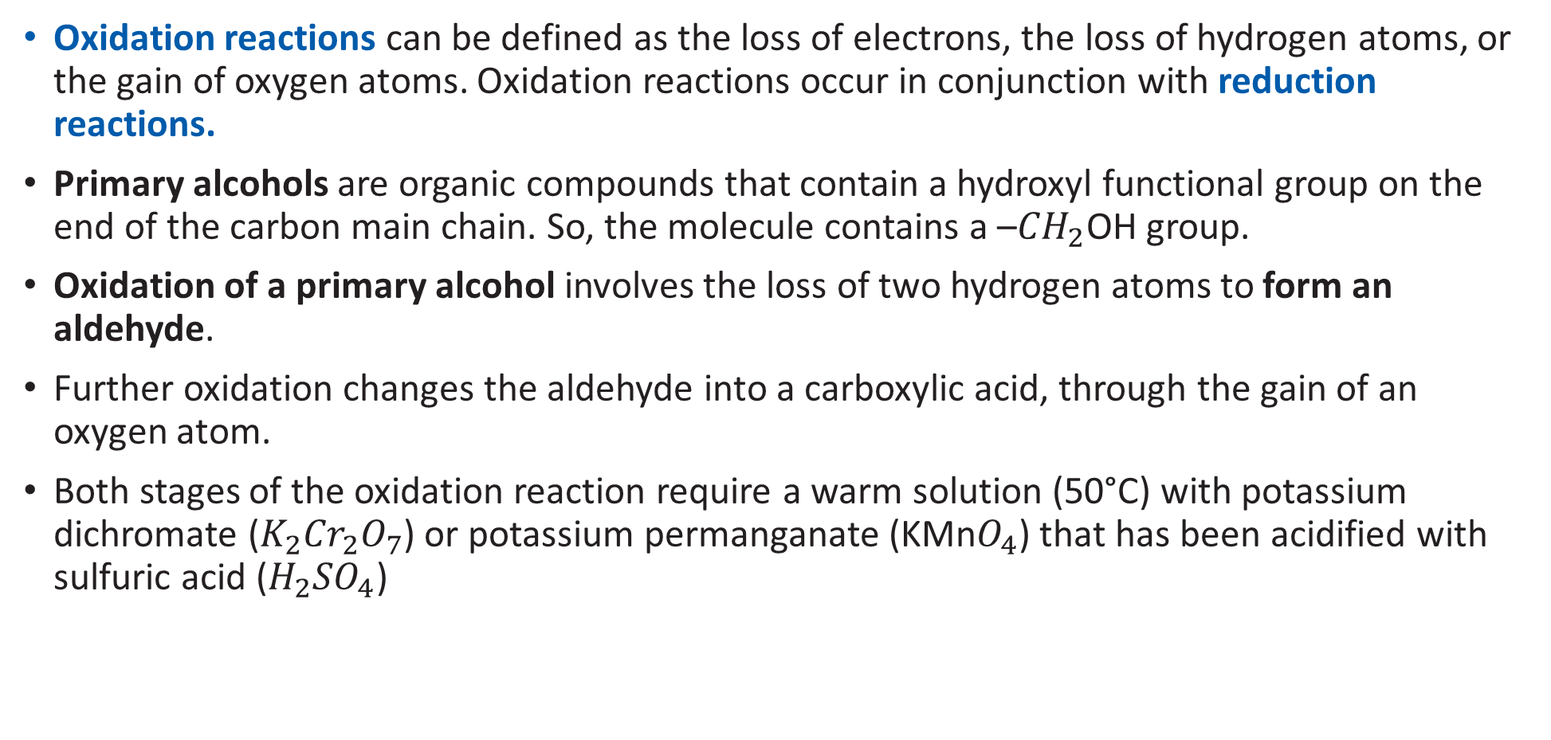
Oxidation Reactions of Primary Alcohols
Oxidation reactions can be defined as the loss of electrons, the loss of hydrogen atoms, or the gain of oxygen atoms. Oxidation reactions occur in conjunction with reduction reactions.
Primary alcohols are organic compounds that contain a hydroxyl functional group on the end of the carbon main chain. So, the molecule contains a –${CH}_{2}$OH group.
Oxidation of a primary alcohol involves the loss of two hydrogen atoms to form an aldehyde.
Further oxidation changes the aldehyde into a carboxylic acid, through the gain of an oxygen atom.
Both stages of the oxidation reaction require a warm solution (50°C) with potassium dichromate ($K_{2}{Cr}_{2}O_{7}$) or potassium permanganate (KMn$O_{4}$) that has been acidified with sulfuric acid ($H_{2}{SO}_{4}$)

Slide 16
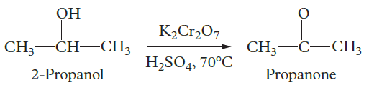
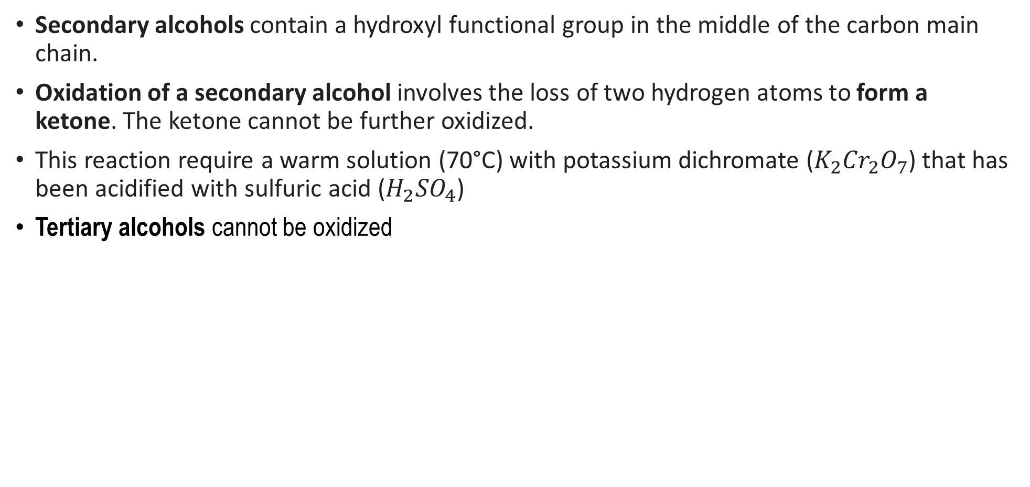
Oxidation Reactions of Secondary Alcohols
Secondary alcohols contain a hydroxyl functional group in the middle of the carbon main chain.
Oxidation of a secondary alcohol involves the loss of two hydrogen atoms to form a ketone. The ketone cannot be further oxidized.
This reaction require a warm solution (70°C) with potassium dichromate ($K_{2}{Cr}_{2}O_{7}$) that has been acidified with sulfuric acid ($H_{2}{SO}_{4}$)
Tertiary alcohols cannot be oxidized

Slide 17
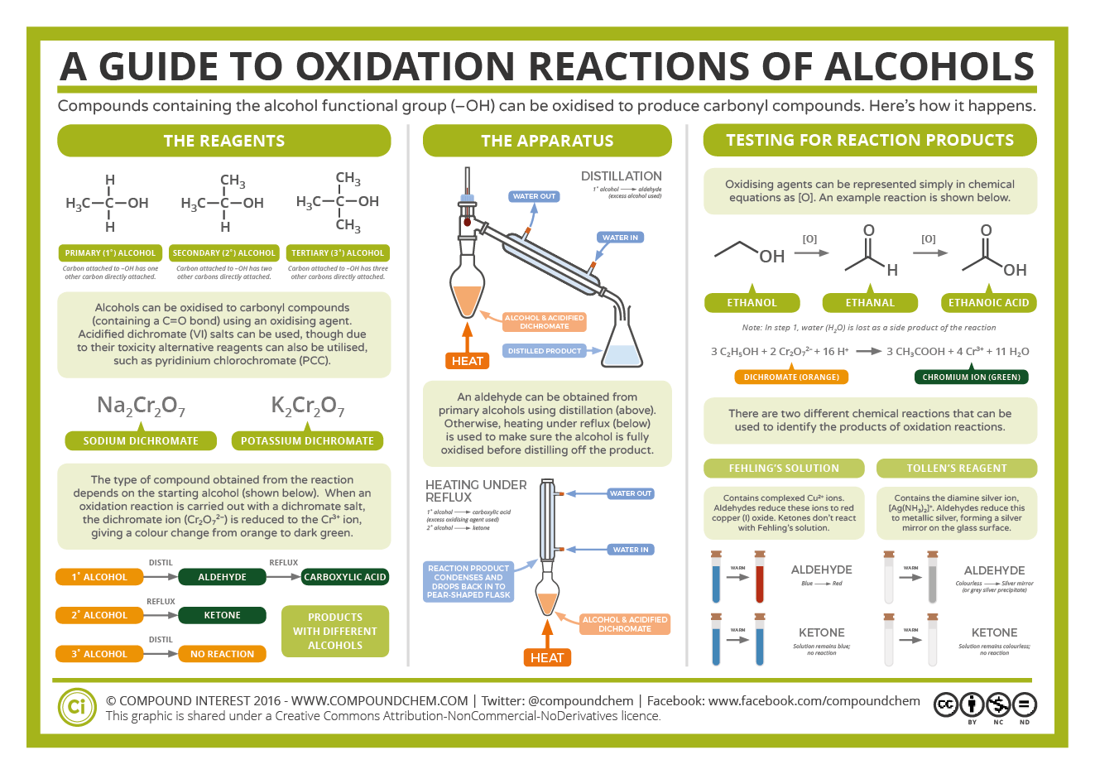

Slide 18
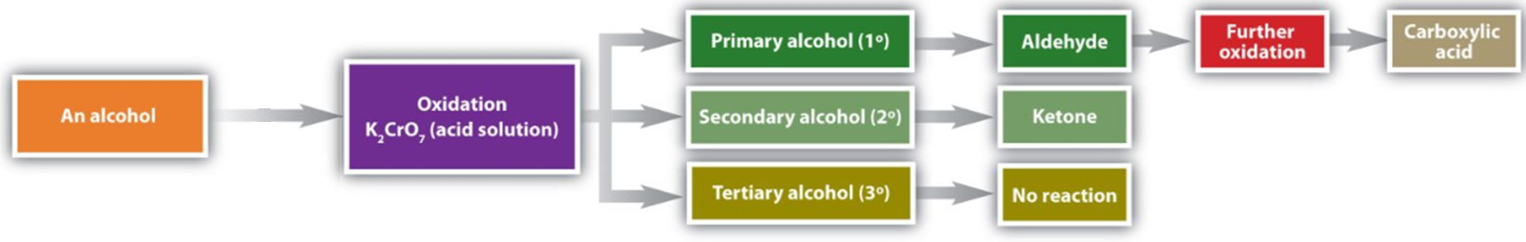
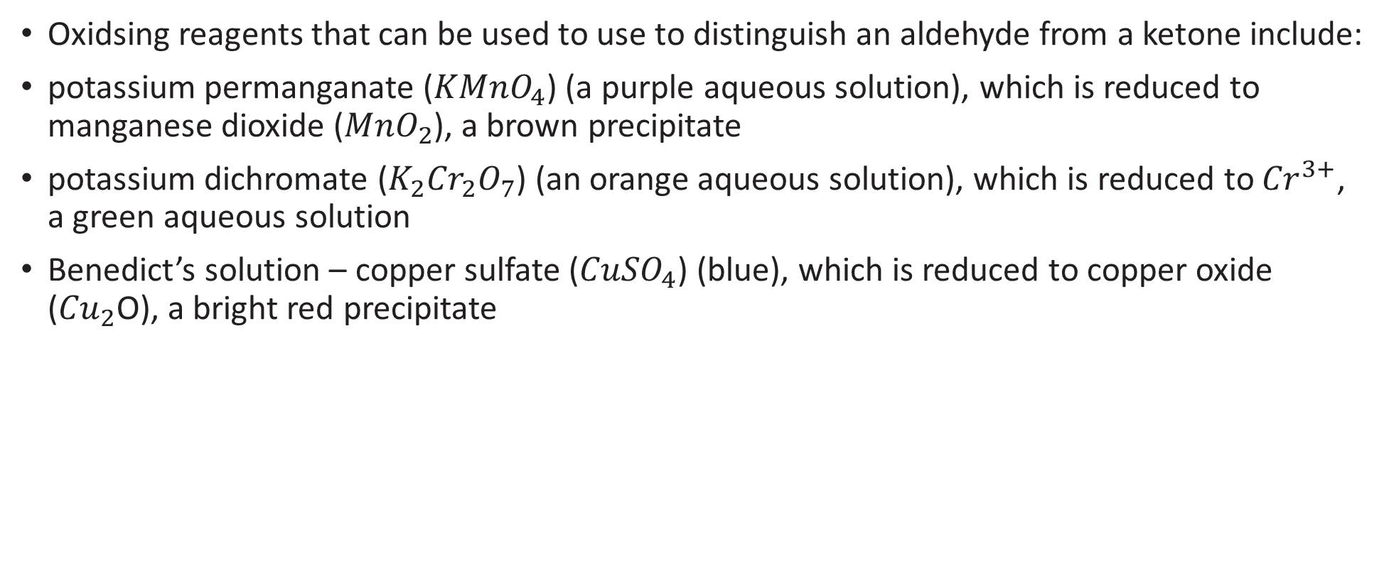
Distinguishing Between Primary, Secondary and Tertiary Reactions
Oxidsing reagents that can be used to use to distinguish an aldehyde from a ketone include:
potassium permanganate (${KMnO}_{4}$) (a purple aqueous solution), which is reduced to manganese dioxide (${MnO}_{2}$), a brown precipitate
potassium dichromate ($K_{2}{Cr}_{2}O_{7}$) (an orange aqueous solution), which is reduced to ${Cr}^{3+}$, a green aqueous solution
Benedict’s solution – copper sulfate (${CuSO}_{4}$) (blue), which is reduced to copper oxide (${Cu}_{2}$O), a bright red precipitate

Slide 19
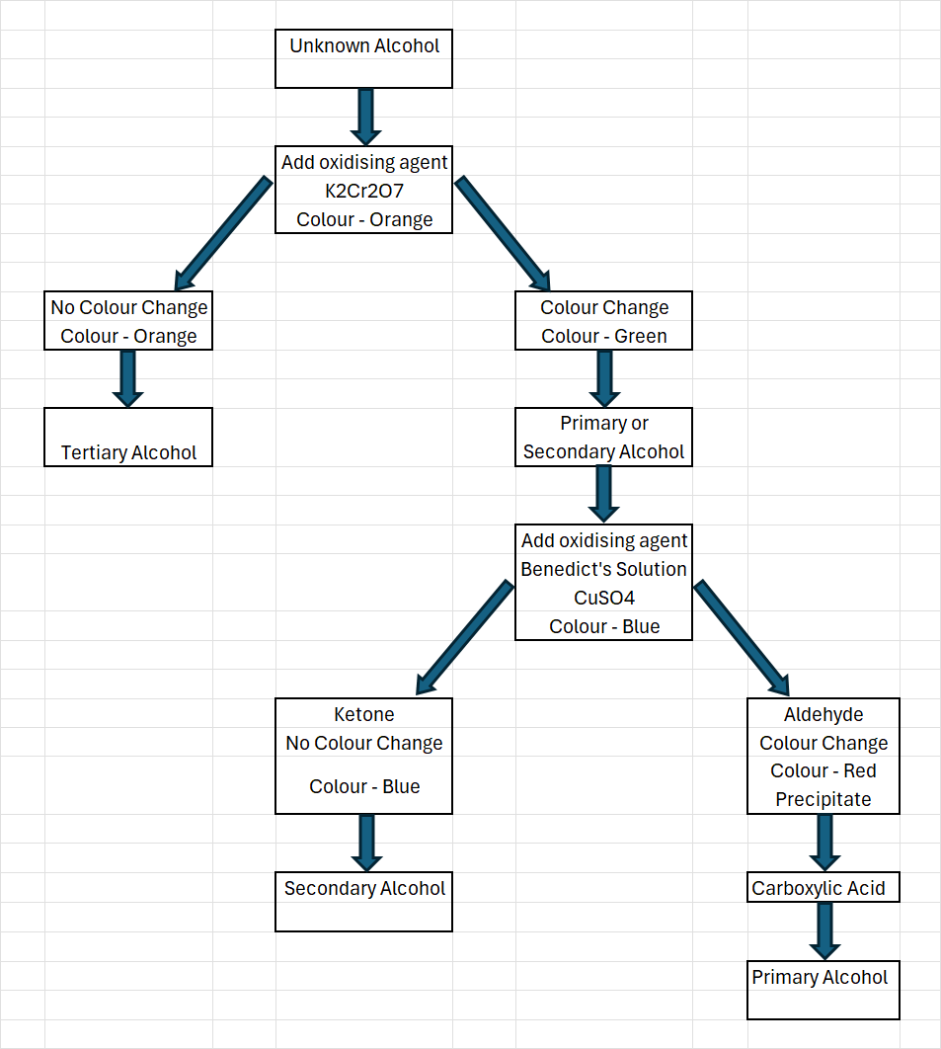
Flowchart for Identifying an Unknown Alcohol p 257 Textbook

Slide 20
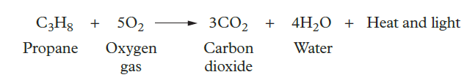
Oxidation of Alkanes and Alcohols by Combustion
Complete combustion reactions are oxidation reactions that involve the exothermic burning of a fuel in excess oxygen to produce carbon dioxide and water.
Common fuels are alcohols and alkanes, such as ethanol, butane, propane and methane.
Complete Combustion Fuel + Oxygen → Carbon Dioxide + Water
When an incomplete combustion occurs
Fuel + Oxygen → Carbon Soot + Carbon Monoxide + Water
or Fuel + Oxygen → Carbon Soot + Water

Slide 21
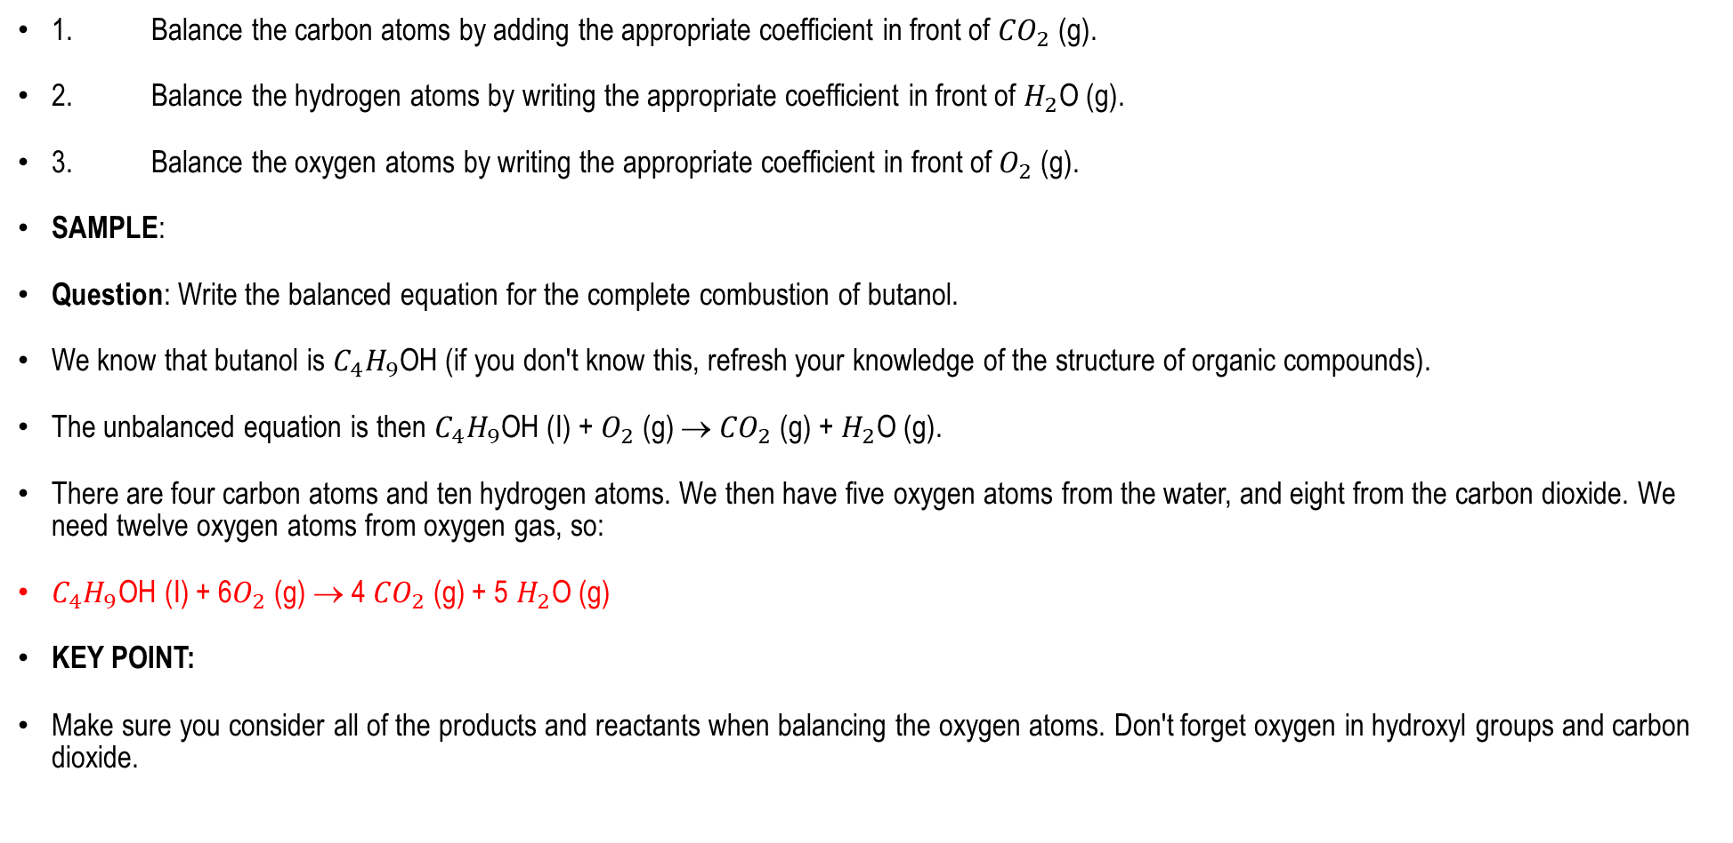
Complete Combustion of Alkanes and Alcohols
1. Balance the carbon atoms by adding the appropriate coefficient in front of ${CO}_{2}$ (g).
2. Balance the hydrogen atoms by writing the appropriate coefficient in front of $H_{2}$O (g).
3. Balance the oxygen atoms by writing the appropriate coefficient in front of $O_{2}$ (g).
SAMPLE:
Question: Write the balanced equation for the complete combustion of butanol.
We know that butanol is $C_{4}H_{9}$OH (if you don't know this, refresh your knowledge of the structure of organic compounds).
The unbalanced equation is then $C_{4}H_{9}$OH (I) + $O_{2}$ (g) → ${CO}_{2}$ (g) + $H_{2}$O (g).
There are four carbon atoms and ten hydrogen atoms. We then have five oxygen atoms from the water, and eight from the carbon dioxide. We need twelve oxygen atoms from oxygen gas, so:
$C_{4}H_{9}$OH (I) + 6$O_{2}$ (g) → 4 ${CO}_{2}$ (g) + 5 $H_{2}$O (g)
KEY POINT:
Make sure you consider all of the products and reactants when balancing the oxygen atoms. Don't forget oxygen in hydroxyl groups and carbon dioxide.

Slide 22
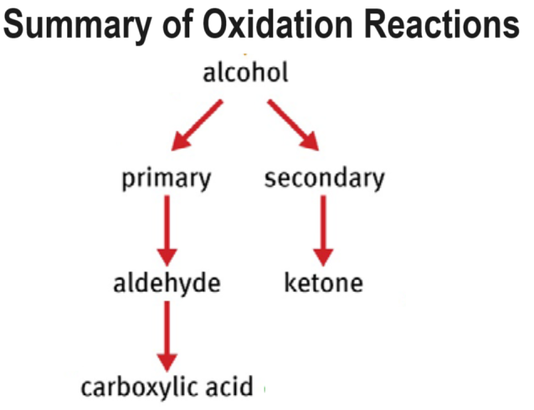

Slide 23
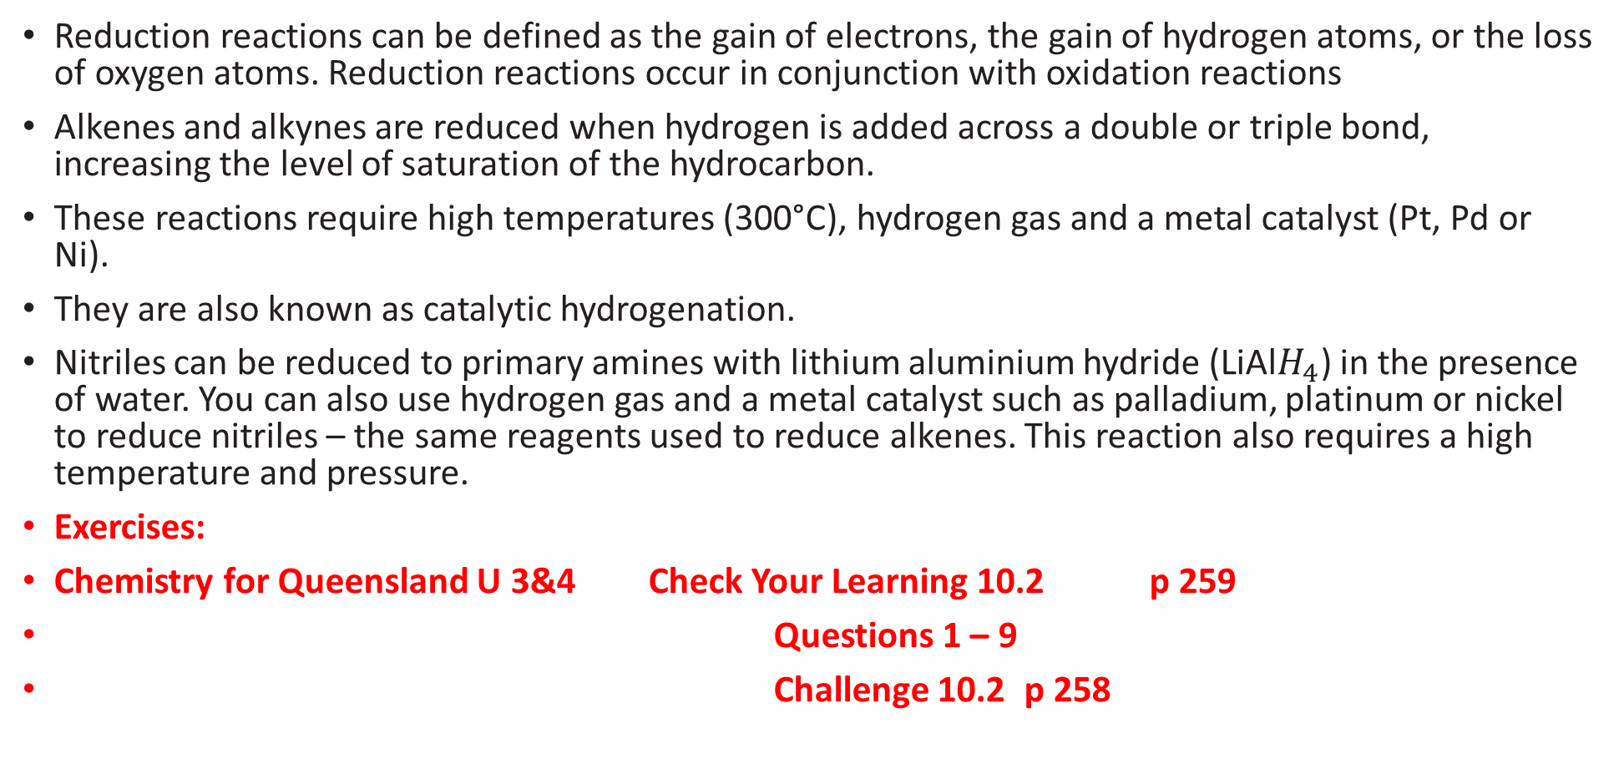
Reduction Reactions
Reduction reactions can be defined as the gain of electrons, the gain of hydrogen atoms, or the loss of oxygen atoms. Reduction reactions occur in conjunction with oxidation reactions
Alkenes and alkynes are reduced when hydrogen is added across a double or triple bond, increasing the level of saturation of the hydrocarbon.
These reactions require high temperatures (300°C), hydrogen gas and a metal catalyst (Pt, Pd or Ni).
They are also known as catalytic hydrogenation.
Nitriles can be reduced to primary amines with lithium aluminium hydride (LiAl$H_{4}$) in the presence of water. You can also use hydrogen gas and a metal catalyst such as palladium, platinum or nickel to reduce nitriles – the same reagents used to reduce alkenes. This reaction also requires a high temperature and pressure.
Exercises:
Chemistry for Queensland U 3&4 Check Your Learning 10.2 p 259
Questions 1 – 9
Challenge 10.2 p 258

Slide 24
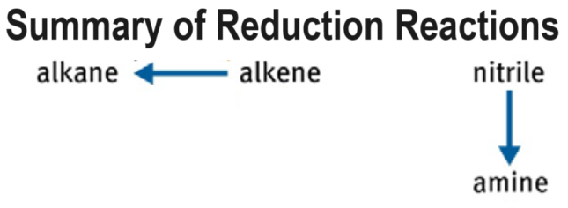

Slide 25
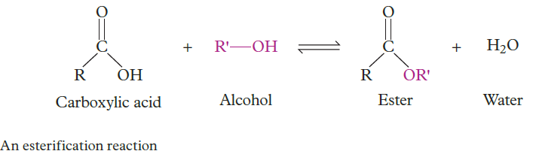
Condensation Reactions
A condensation reaction occurs when two molecules combine to form a larger molecule and a small by-product such as water.
Amides and esters are synthesised by condensation reactions.
Esterification is a condensation reaction between a carboxylic acid and an alcohol that generates an ester
Esterification Carboxylic Acid + Alcohol → Ester + Water
The reaction requires heat and trace amounts of a mineral acid catalyst such as sulfuric acid. It is a reversible reaction.
The main chain of the ester is derived from the main chain of the carboxylic acid (R). The alcohol main chain forms the ester substituent (R′).
Esters are weak acids because they are in equilibrium with the parent carboxylic acids. As a result, an ester turns litmus paper from blue to red.
WORKED EXAMPLE 10.3
Identify the ester that is synthesised from propanoic acid and hexan-1-ol.

Slide 26
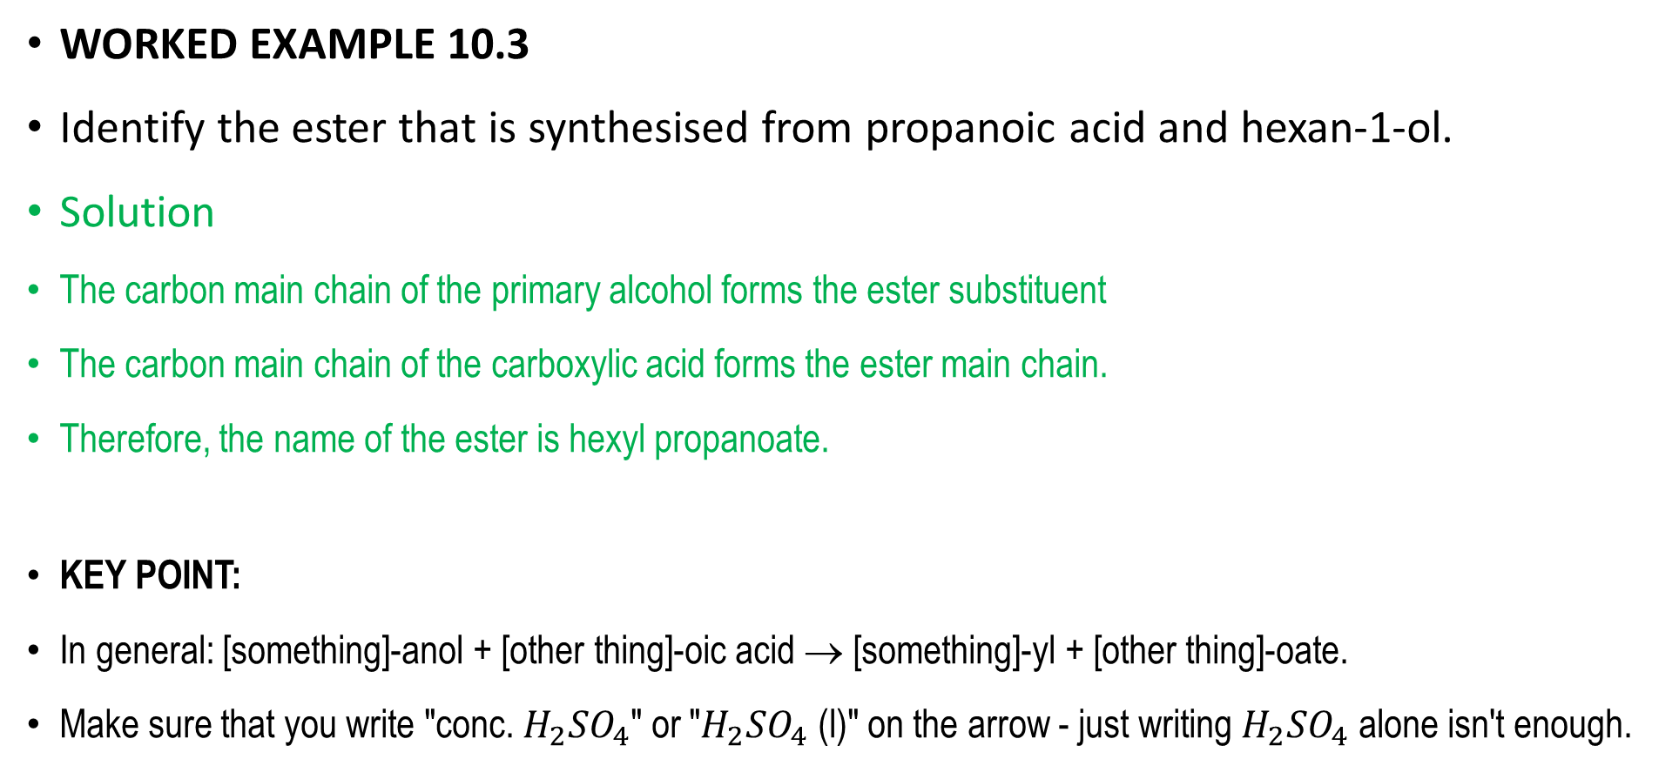
Worked Example Solutions
WORKED EXAMPLE 10.3
Identify the ester that is synthesised from propanoic acid and hexan-1-ol.
Solution
The carbon main chain of the primary alcohol forms the ester substituent
The carbon main chain of the carboxylic acid forms the ester main chain.
Therefore, the name of the ester is hexyl propanoate.
KEY POINT:
In general: [something]-anol + [other thing]-oic acid → [something]-yl + [other thing]-oate.
Make sure that you write "conc. $H_{2}{SO}_{4}$" or "$H_{2}{SO}_{4}$ (l)" on the arrow - just writing $H_{2}{SO}_{4}$ alone isn't enough.

Slide 27
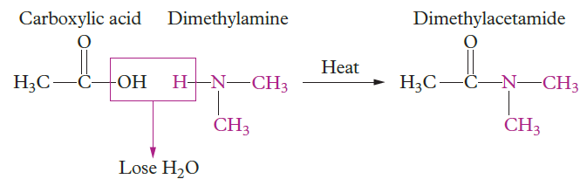
Condensation Reactions of Amines
Amides are synthesised from carboxylic acids and amines. The reaction requires heat (>100°C) and is reversible (similar to esterifications) with the by-product water, comes from the hydroxyl group and a hydrogen from the amine functional group.
The amine reactant is a weak base because it has a non-bonding pair of electrons, which can bond with hydrogen ions from water and acids about 7% of the time. Red litmus paper can be used to monitor the reaction progress because it will turn blue if there is still amine reactant present
Carboxylic Acid + Amine → Amide + Water
Exercises:
Chemistry for Queensland U 3&4
Check Your Learning 10.3 p 262 Questions 1 – 9
Case Study 10.3 p 261

Slide 28
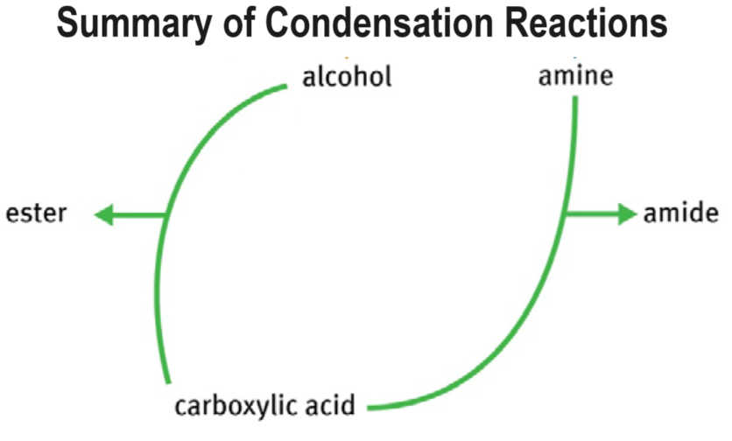

Slide 29
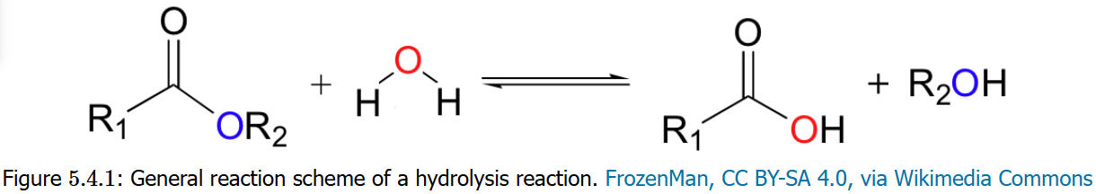
Hydrolysis Reactions
Hydrolysis reactions are the reverse of condensation reactions. In a hydrolysis reaction, a larger molecule forms two (or more) smaller molecules and water is consumed as a reactant. Hydrolysis ("hydro" = water and "lysis" = break) involves adding water to one large molecule to break it into multiple smaller molecules. Water is split in the process.
An example is the hydrolysis of an ester, in which water breaks the ester into carboxylic acid and alcohol. This hydrolysis can occur under acidic or basic conditions. This reaction is the reverse of estification.

Slide 30
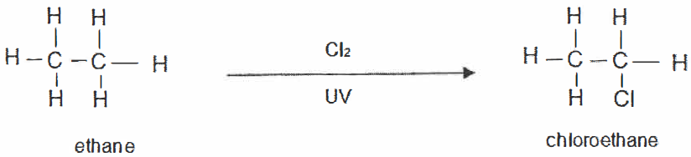
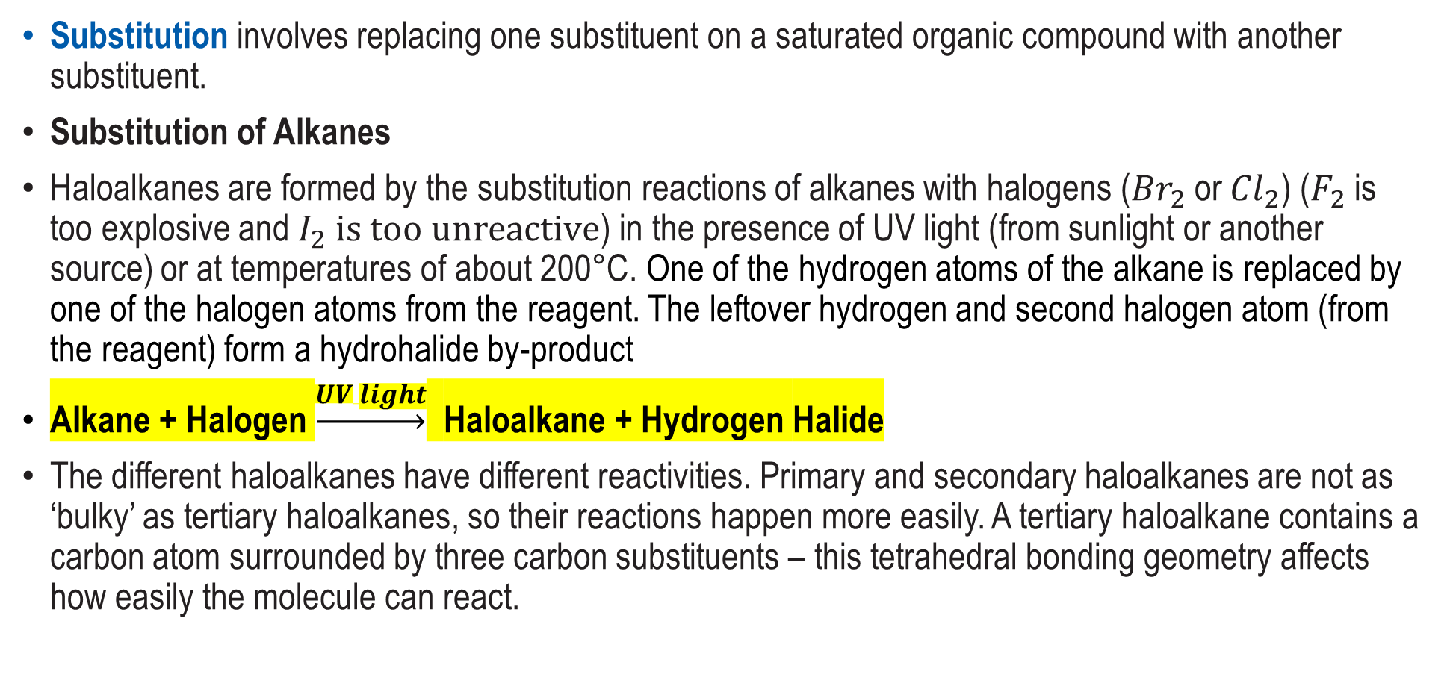
Substitution Reactions
Substitution involves replacing one substituent on a saturated organic compound with another substituent.
Substitution of Alkanes
Haloalkanes are formed by the substitution reactions of alkanes with halogens (${Br}_{2}$ or ${Cl}_{2}$) ($F_{2}$ is too explosive and $I_{2} is too unreactive$) in the presence of UV light (from sunlight or another source) or at temperatures of about 200°C. One of the hydrogen atoms of the alkane is replaced by one of the halogen atoms from the reagent. The leftover hydrogen and second halogen atom (from the reagent) form a hydrohalide by-product
Alkane + Halogen $\underset{→}{UV light}$ Haloalkane + Hydrogen Halide
The different haloalkanes have different reactivities. Primary and secondary haloalkanes are not as ‘bulky’ as tertiary haloalkanes, so their reactions happen more easily. A tertiary haloalkane contains a carbon atom surrounded by three carbon substituents – this tetrahedral bonding geometry affects how easily the molecule can react.

Slide 31
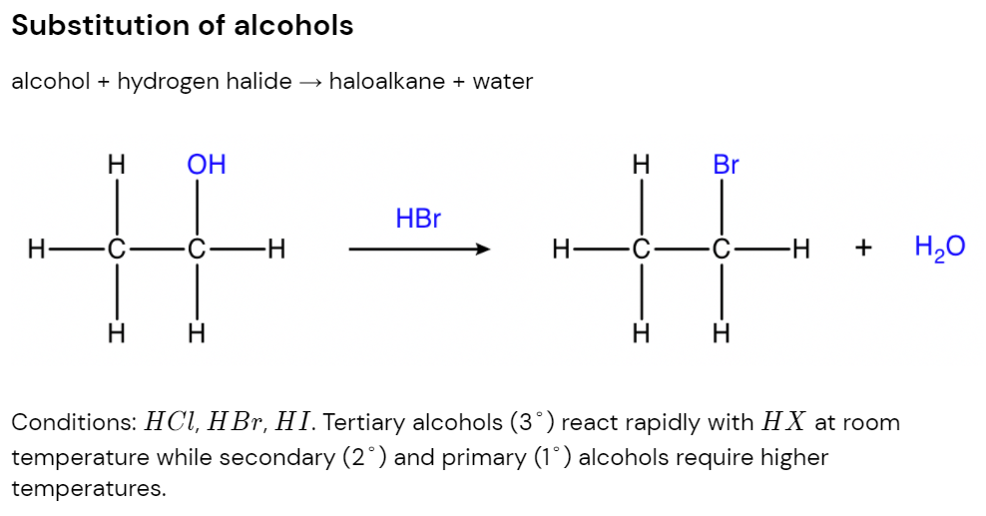
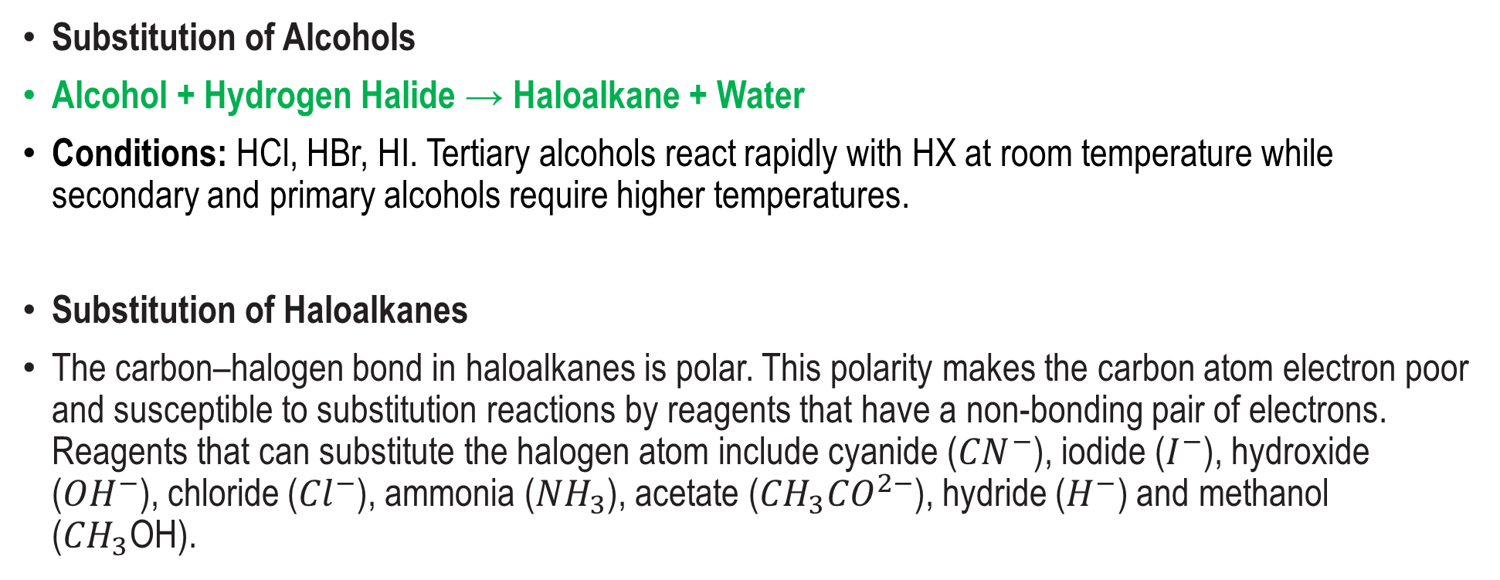
Substitution Reactions - Overview
Substitution of Alcohols
Alcohol + Hydrogen Halide → Haloalkane + Water
Conditions: HCl, HBr, HI. Tertiary alcohols react rapidly with HX at room temperature while secondary and primary alcohols require higher temperatures.
Substitution of Haloalkanes
The carbon–halogen bond in haloalkanes is polar. This polarity makes the carbon atom electron poor and susceptible to substitution reactions by reagents that have a non-bonding pair of electrons. Reagents that can substitute the halogen atom include cyanide (${CN}^{−}$), iodide ($I^{−}$), hydroxide (${OH}^{−}$), chloride (${Cl}^{−}$), ammonia (${NH}_{3}$), acetate (${CH}_{3}{CO}^{2−}$), hydride ($H^{−}$) and methanol (${CH}_{3}$OH).

Slide 32
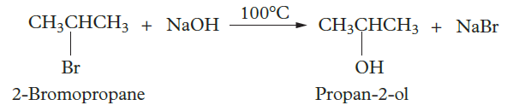
Substitution Reactions Examples
Using Sodium Hydroxide
Haloalkane + Sodium / Potassium Hydroxide → Alcohol + Metal Halide
If you heat a haloalkane with a solution of sodium or potassium hydroxide in 50:50 ethanol and water under reflux, the halogen substituent is replaced by a hydroxyl functional group (to product an alcohol).
The nature of this substitution means that a primary haloalkane will produce a primary alcohol, a secondary haloalkane would produce a secondary alcohol, and a tertiary haloalkane would produce a tertiary alcohol.

Slide 33


More Substitution Reactions Examples
Using Ammonia
Our second example also doesn't require a catalyst. When reacted with a concentrated solution of ammonia in ethanol, haloalkanes become amines.
Using Cyanide
For this third example, we need to pay attention to the conditions. We can react haloalkanes with cyanide (we use potassium cyanide for this) to produce nitriles, but if we do this in just water, the haloalkane will ignore the cyanide and produce an alcohol instead. To avoid this, we conduct the reaction in ethanol.

Slide 34

Still More Substitution Reactions Examples
Using Halogens
If you add a haloalkane (RX) to a solution of sodium iodide in ethanol (or another organic solvent) and stir, the halogen will be substituted by iodine
Exercises:
Chemistry for Queensland U 3&4 Check Your Learning 10.4 p 265 Questions 1 – 6
Challenge 10.4 p 264
Chapter 10 Revision p 271 Q 1 - 30

Slide 35


Slide 36



Other Reactions
Saponification
Ester + Sodium Hydroxide → Sodium Carboxylate + Alcohol
Conditions: NaOH(aq), Heat.
Fermentation of Glucose
Glucose → Ethanol + Carbon Dioxide
Fermentation involves the following four conditions
1. Presence of an enzyme called zymase (found in yeast)
2. Warm temperatures (30 – 40 ${}_{}^{o}C$)
3. Anaerobic environment (absence of oxygen)
4. Aqueous solution

Slide 37
Reaction Pathways
It's important that you're able to. piece together a chain of reactions to convert an organic molecule into the desired product. For example, if you're presented with two solutions of alcohol and told to make an ester, you should be able to 'fill in the blank' and realise that one of the alcohols needs to be oxidised into a carboxylic acid. Luckily, the syllabus states that conversions with more than two stages will not be assessed, so this is all you have to know.
KEY POINT:
To practise your ability in this area, I recommend you make a flow chart connecting all of the reaction types together from memory. Then use these notes to check if you've got the reactions correct, and finally check against the flowchart in the syllabus to see if you have all of the links. It can be hard to remember all of these at first so I encourage making multiple attempts.

Slide 38
Summary of the Chemical Pathways:

Slide 39


